Slide 1
Web Community Manager Subsite Director Workshop
Today’s Trainer: Kit Archie

Slide 2
At the end of today’s hands-on workshop you will be able to:
Lay out a Homepage using typical homepage apps.
Use the functionality of the Calendar App.
Understand the tools available in the Site Workspace.
Begin building the navigational structure of Channels and Sections.
Identify differences between Administrative and Editing Privileges.
Assign various Editing Privileges to Users.

Slide 3
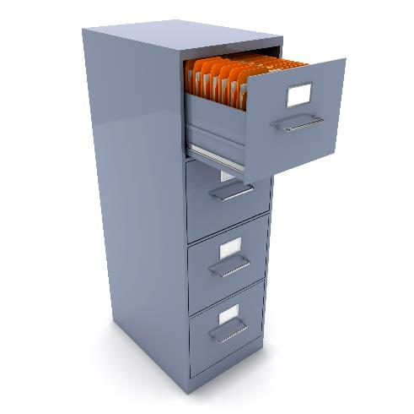
This file cabinet represents your site/sub-site.
Within each Channel (DRAWER) is one or more folders or SECTIONS.
Within each Section (folder) are the PAGES of information about that section.
Each CHANNEL is like a DRAWER - containing similar information.

Slide 4
Your URL
www.bcscschools.org

Slide 5
Editorial Privileges
SITE DIRECTOR
Channel Director
Channel Director
Section Editor
Section Editor
Homepage Editor
Section Editor
Section Editor
SUBSITE DIRECTOR
SUBSITE DIRECTOR
Channel Director
Channel Director
Channel Director
Channel Director
Section Editor
Homepage Editor
Section Editor
Section Editor
Homepage Editor
Section Editor
Section Editor
Section Editor
Section Editor
Section Editor

Slide 6
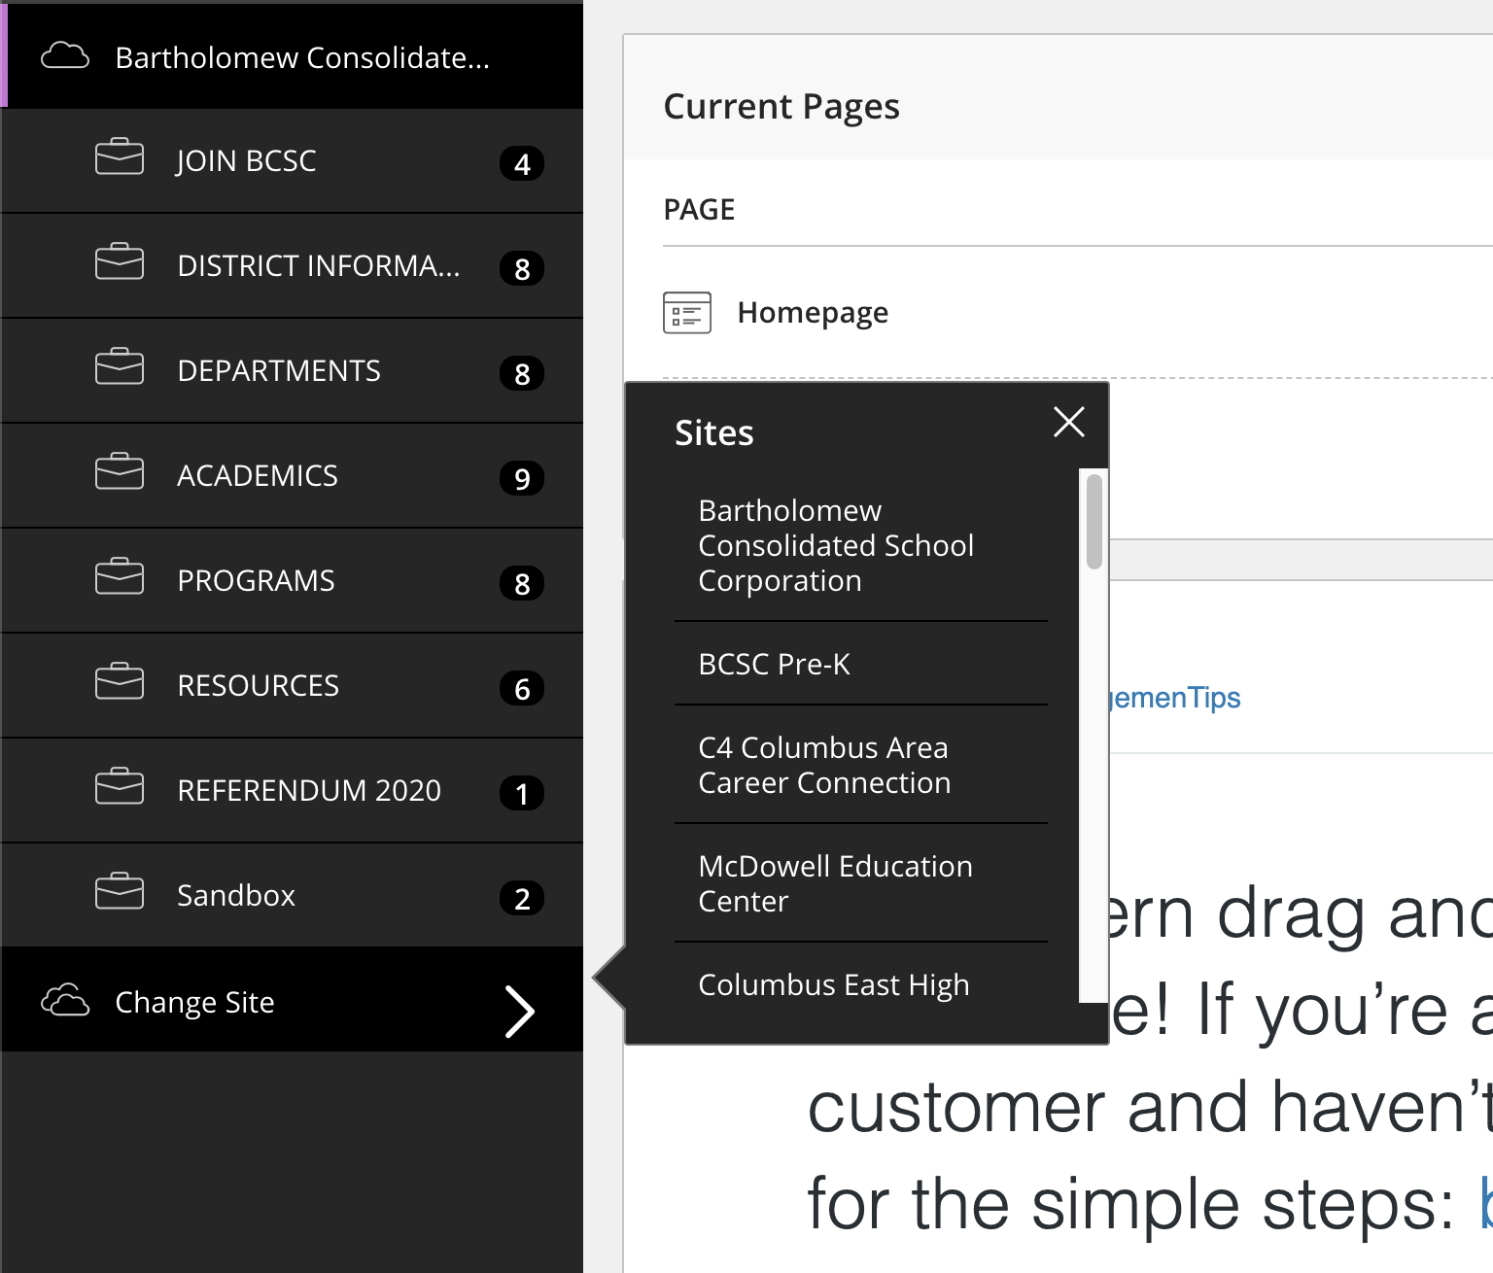
Activity: Choose a Subsite
Now It’s Your Turn.

Slide 7
Homepage Region Map for Empire

Slide 8
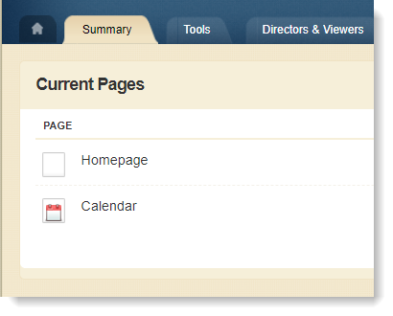
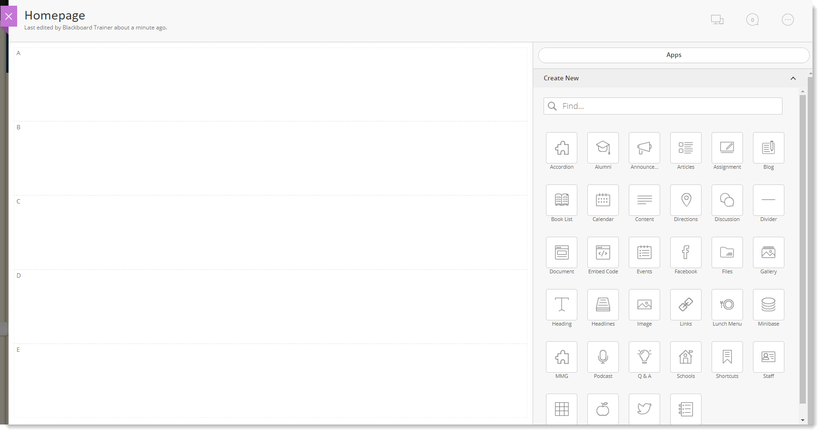
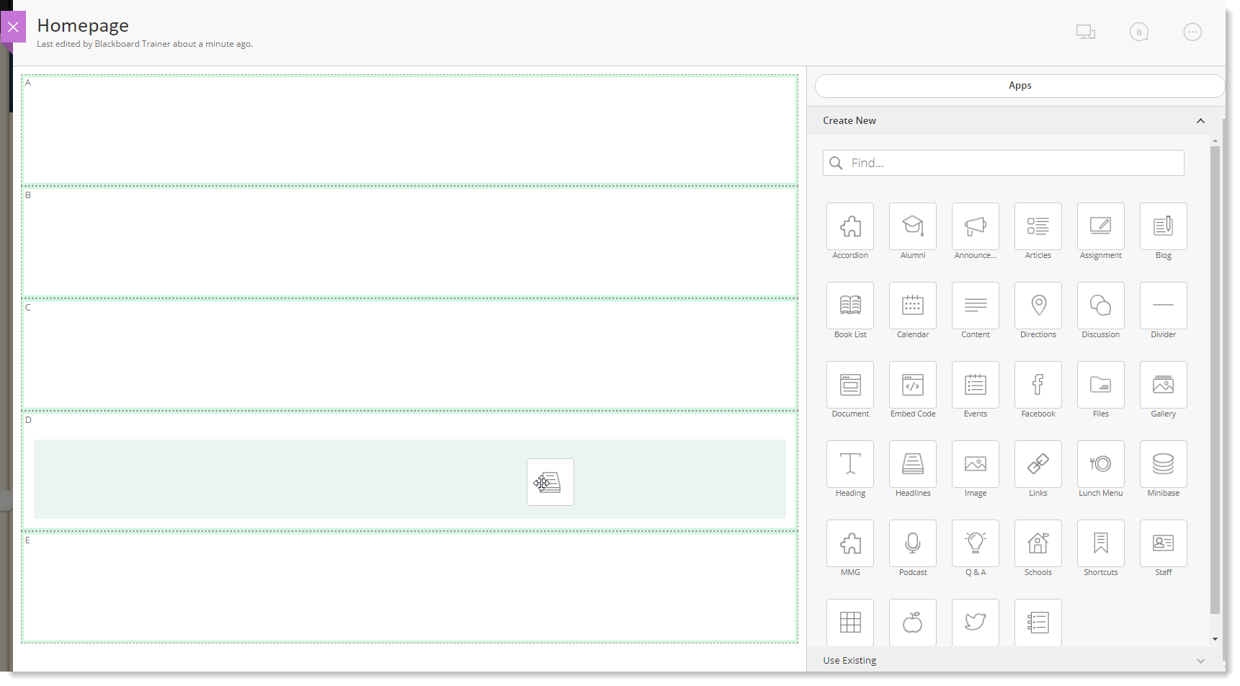
Opening & Editing the Homepage
Note lettered regions
Canvas
Apps
Drag and Drop
Drag and Drop

Slide 9
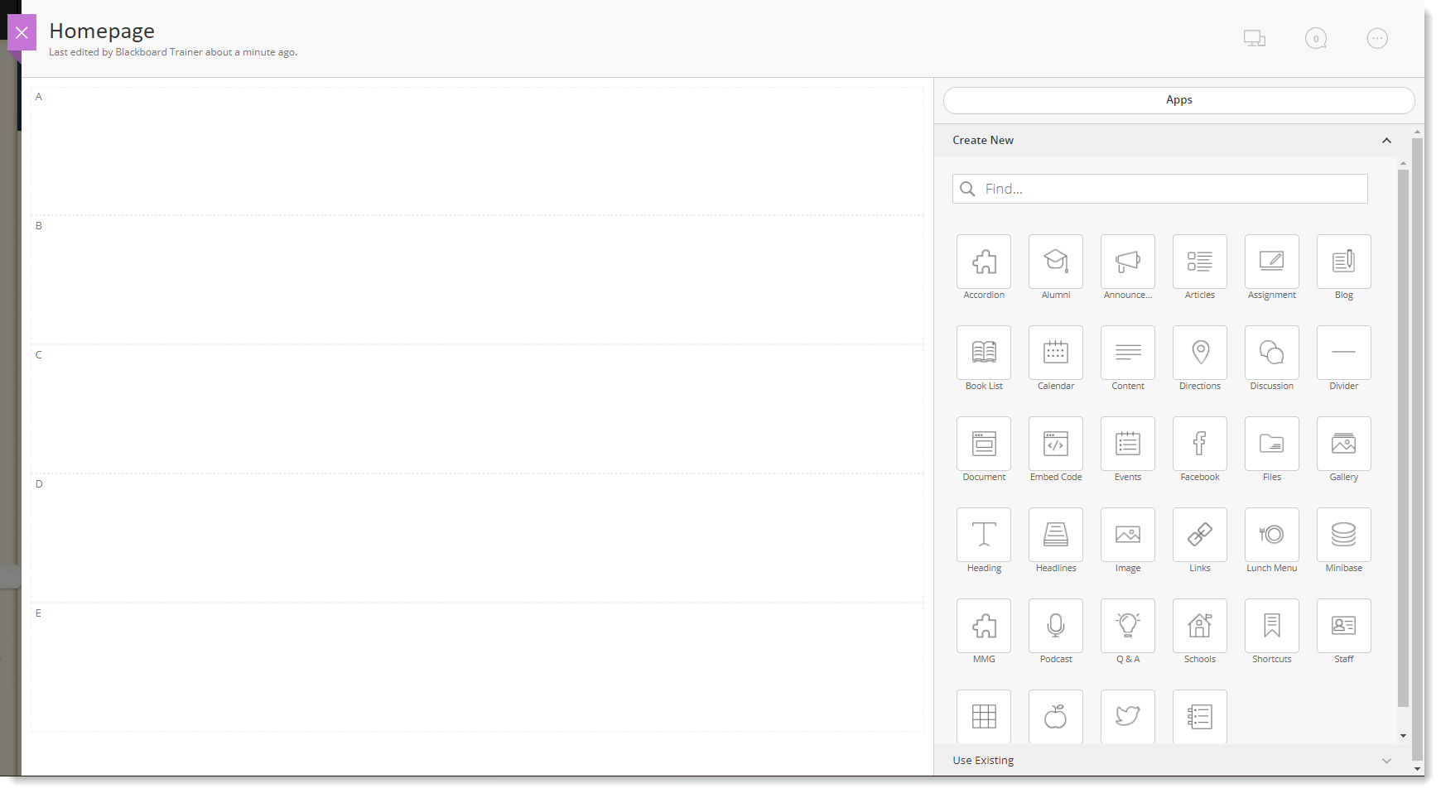
Activity: Add and Position Apps
Headlines App: “Latest News”
Announcements App: “Announcements”
Site Shortcuts App: “Quick Links”
Upcoming Events App: “Upcoming Events”

Slide 10
Homepage with Apps

Slide 11
Activity: Edit Site Shortcuts App
Click pencil to open app, or click plus sign to add a single link.

Slide 12
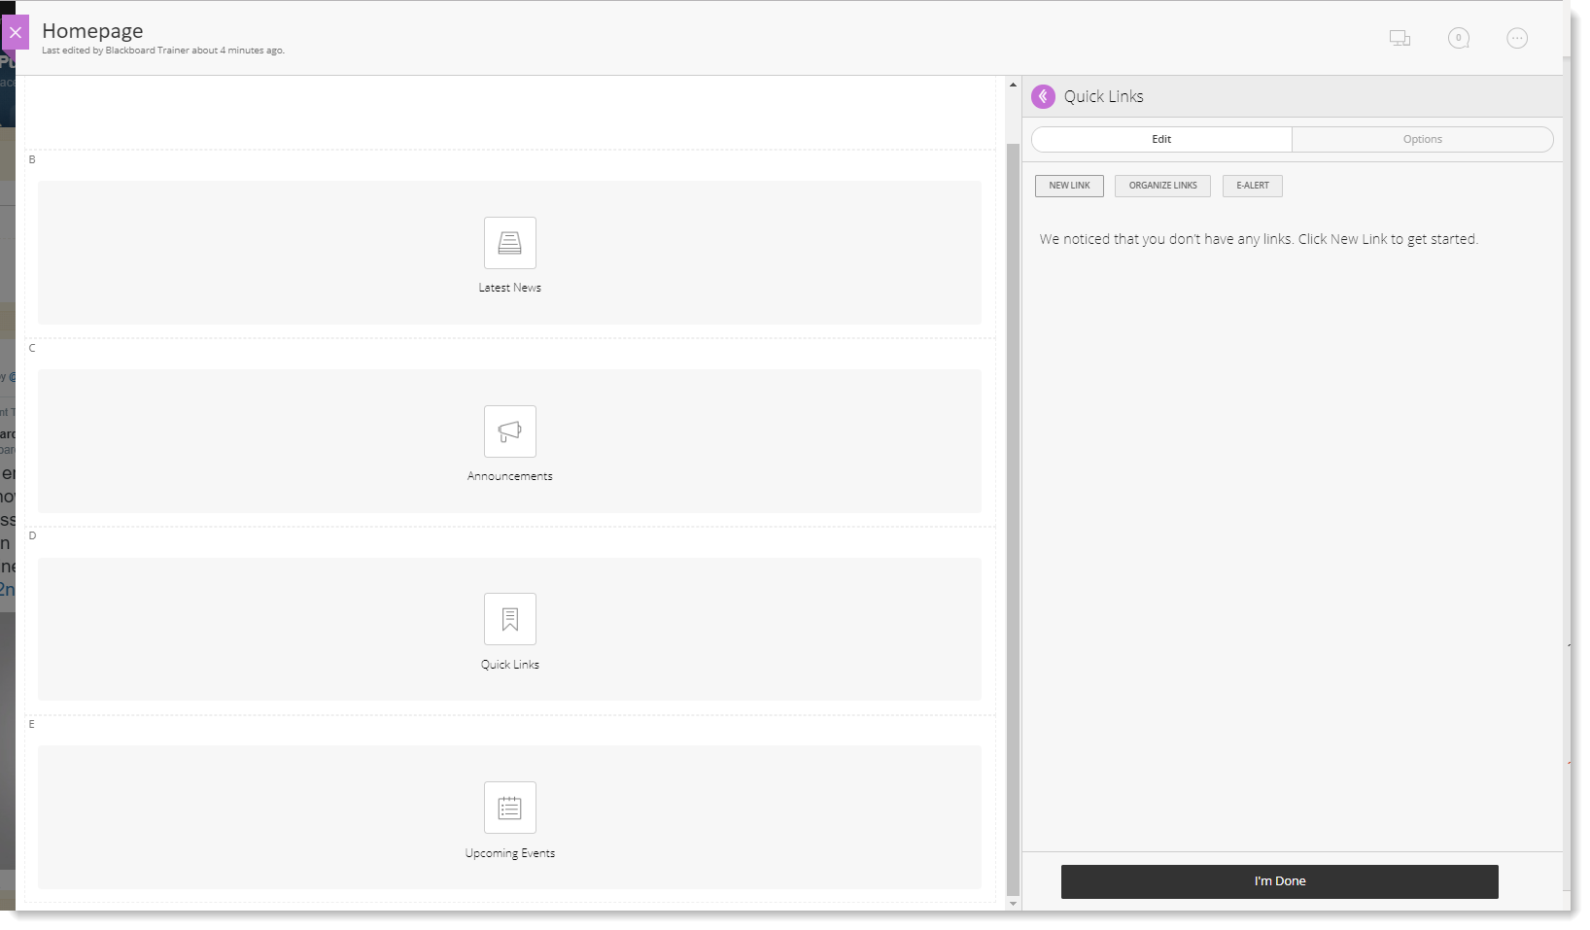
Sidebar Apps
Some apps open in the sidebar; click the purple arrow to expand the sidebar if you need more room to edit.

Slide 13
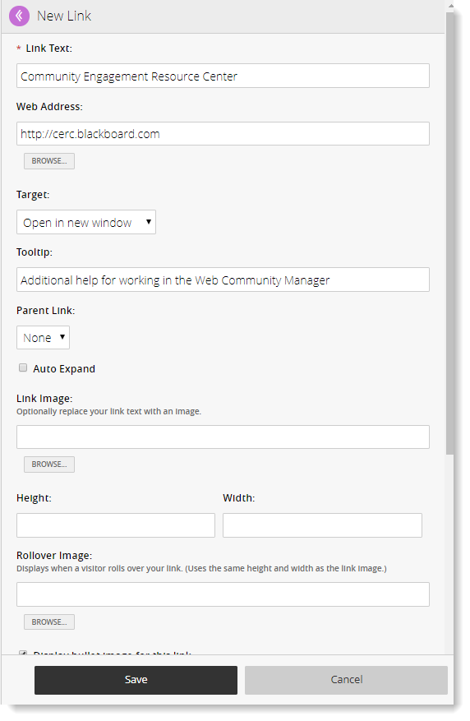
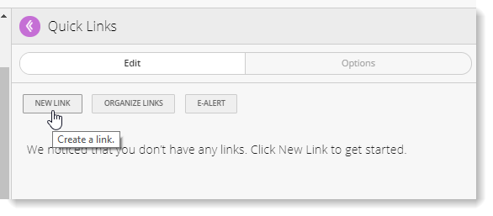
Activity: Add a link to the Site Shortcuts App
Click the New Link button.

Slide 14
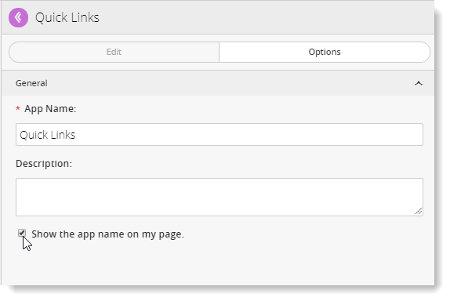
Activity: Edit the App Options
Click on the Options tab and check the box to Show the App Name.

Slide 15
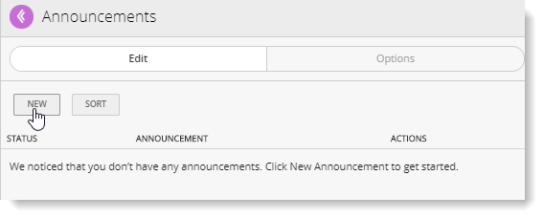
Activity: Add an Announcement
Click the pencil to edit the Announcements app.
Click the New button to add an announcement.

Slide 16
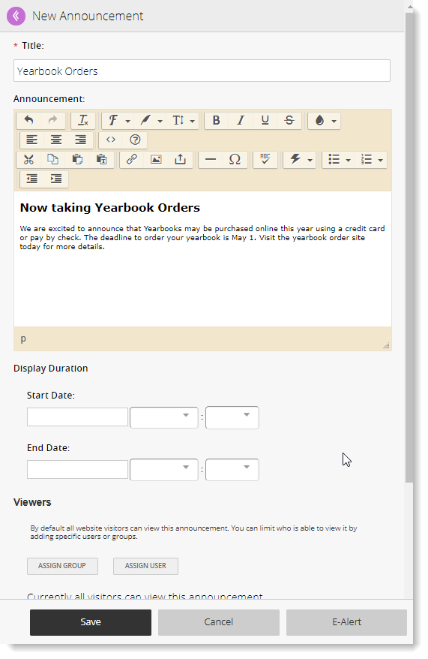
Adding an Announcement
Enter an Announcement title (does not display on website) and body.
Set display duration if desired.

Slide 17
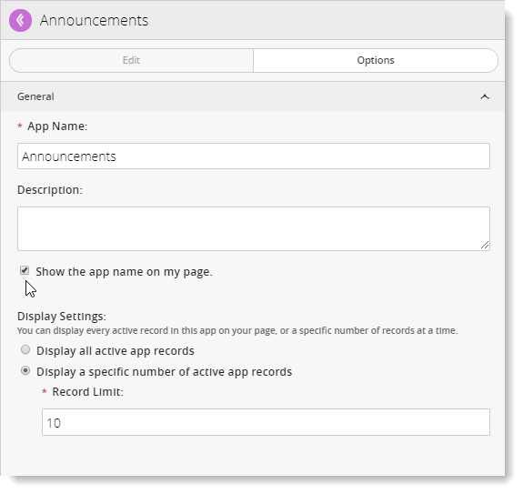
Announcement App Options
Click on the Options tab to show the app name and access display settings.

Slide 18
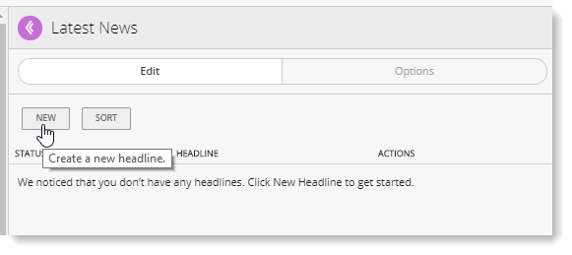
Activity: Add a Headline
Click the pencil to edit the Headlines & Features app.
Click the New button to add a headline.

Slide 19
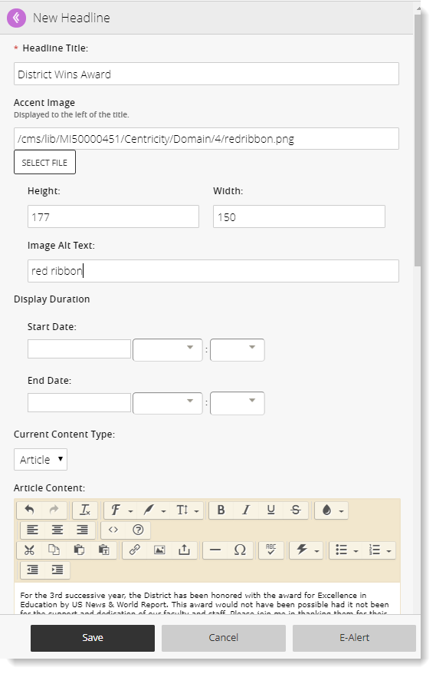
Adding a Headline
Enter Headline title.
Add Accent Image if desired (be sure to include alt text).
Select Content Type: Article, File, Link
Article: Enter content and teaser text
File: Upload PDF and enter description
Link: Enter URL and description

Slide 20
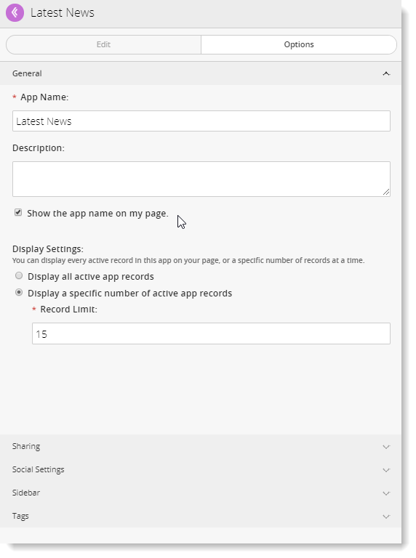
Headlines & Features App Options
General: Show the app name, Display Settings
Sharing: Allows you to place the app in other areas of the website

Slide 21
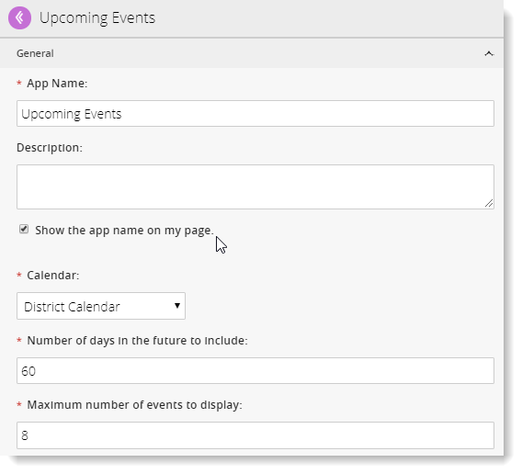
Activity: Edit Upcoming Events App Options
Check box to show the app name on the page.
Select the available calendar in the drop-down.
Set “number of days in the future to include” to 60 or 90.
Set “maximum number of events to display” to 6-8.

Slide 22
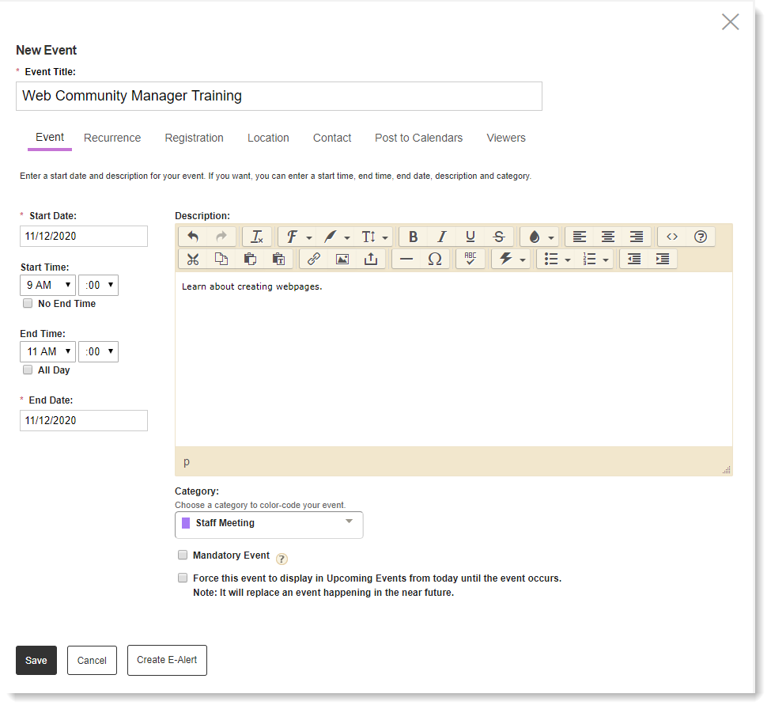
Activity: Add an Event to the Calendar
Double-click the date or click the New Event button.
Enter Event title.
Select start/end dates, start/end times, or select “No End Time” or “All Day.”
Enter event Description (optional).
Select event Category (optional).
Mandatory Event box available on main district calendar only; pushes event to every calendar.

Slide 23
Tools Tab

Slide 24
Files & Folders
Each workspace has its own set of Files & Folders.
Storage location for documents and images used in that workspace.
From district level, you can add items to the Shared Library that will be available to all editors in all workspaces.

Slide 25
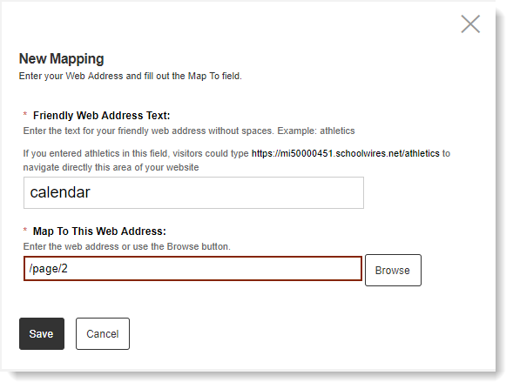
Activity: Create a Friendly Web Address Mapping
Create memorable URLs for frequently-accessed pages, or pages you will promote via emails, flyers, or posters.

Slide 26
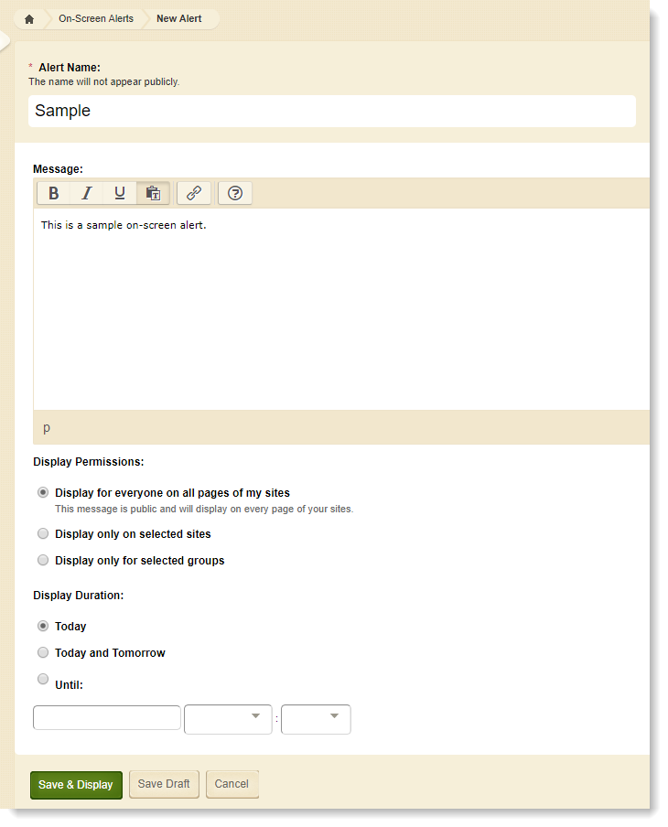
Activity: Create an On-Screen Alert
Pop-ups that can display on all sites, some sites, or just for certain groups.

Slide 27
Section Recycle Bin
Each site and subsite has a recycle bin for deleted sections. You can restore or fully delete sections from the recycle bin.

Slide 28
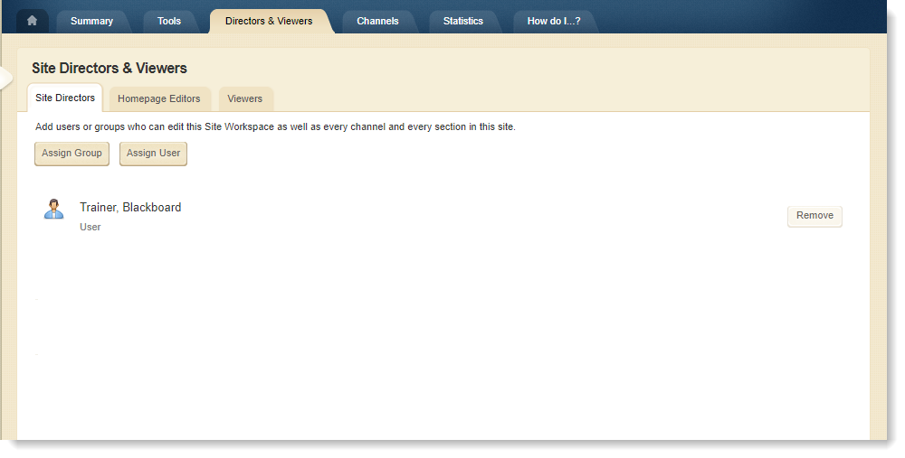
Directors & Viewers
Assign site/subsite director privileges (full editing rights)
Assign Homepage/Calendar editing rights
Restrict viewers for the site/subsite

Slide 29
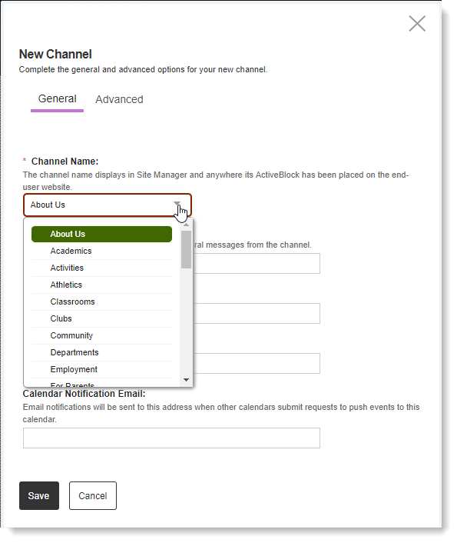
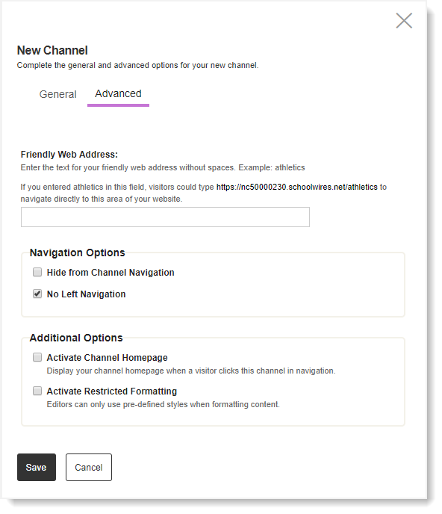
Activity: Assign a Channel
Click Assign Channel, select name from drop-down, activate channel homepage if desired.

Slide 30
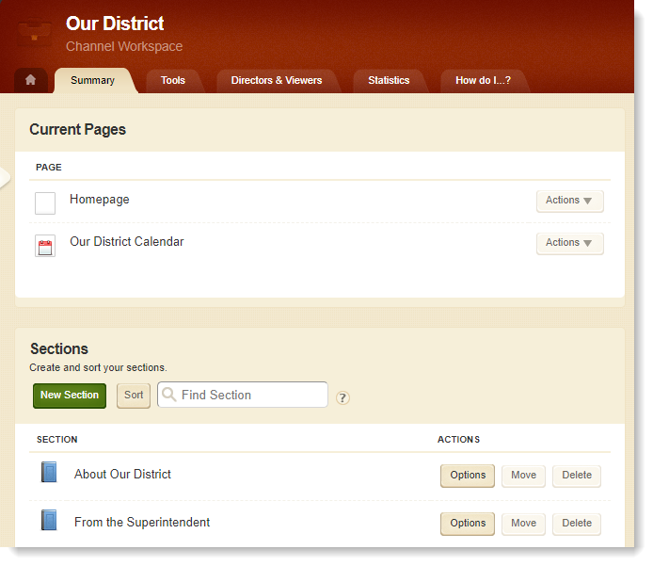
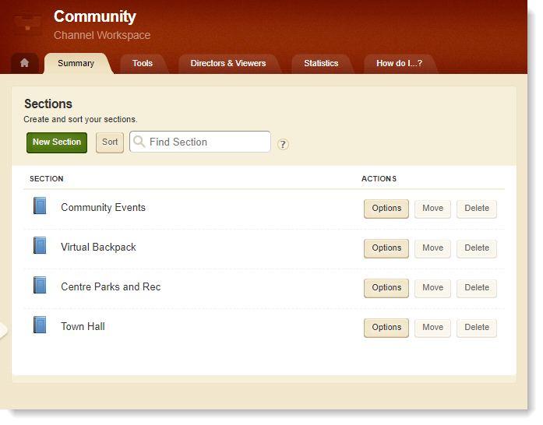
Channel Homepages
If channel homepage is activated, clicking on channel name takes you to channel homepage.
If channel homepage is not activated, clicking on channel name takes you to first section (or directory if more than 15 sections).

Slide 31
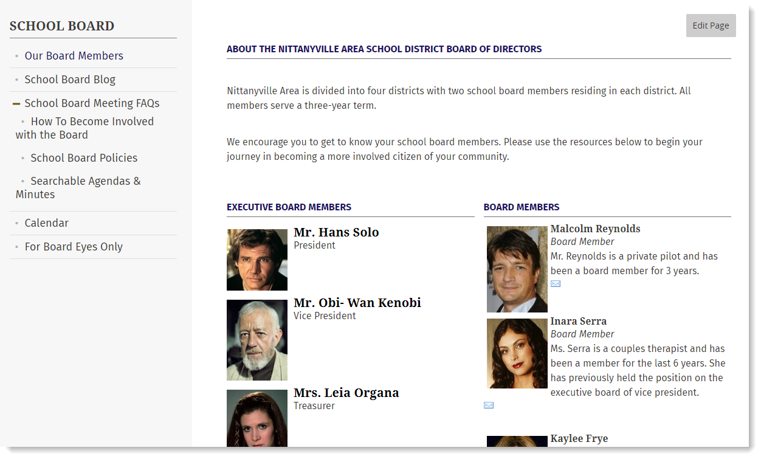
Section Types
There are three types of sections:
Single page (For Students > Student Handbook)
Multiple pages (shown, right) (Our District > School Board)
Redirect to a URL (For Students > Scholarships)

Slide 32
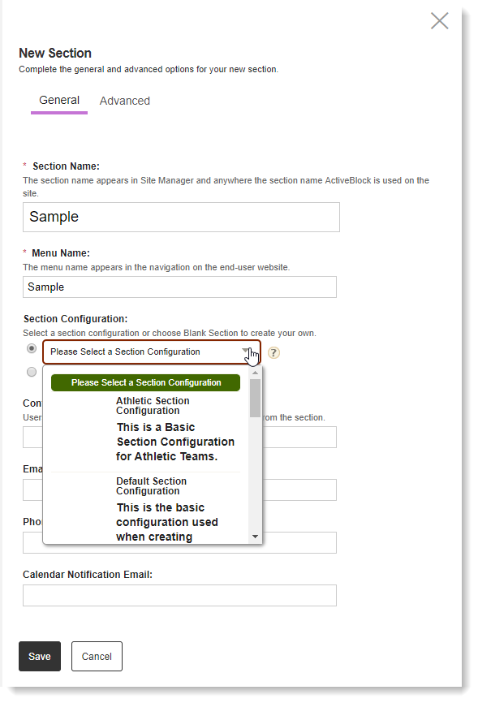
Activity: Create a Section
You can create a blank section (for redirects) or select a Section Configuration from the drop-down
Creates section with a package of starter pages
Promotes consistency

Slide 33
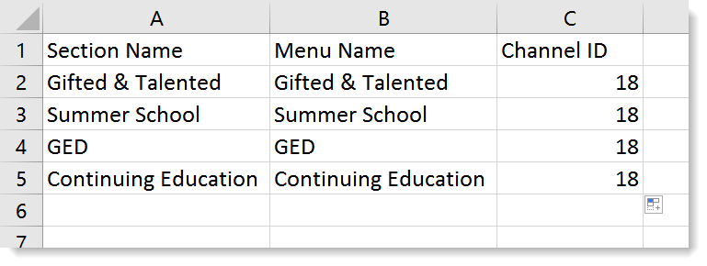
Section Robot
Upload a .csv file to create many sections at once

Slide 34
In today’s workshop we learned how to:
Lay out a Homepage using typical homepage apps.
Use the functionality of the Calendar App.
Understand the tools available in the Site Workspace.
Begin building the navigational structure of Channels and Sections.
Identify differences between Administrative and Editing Privileges.
Assign various Editing Privileges to Users.

Slide 35
We hope you’ve enjoyed today’s Workshop.
Let us know how we’re doing!
https://cerc.blackboard.com/trainingfeedback

